Slide 1
Degree of Collaboration Abacus: Visualization Tool Representing Community Partner Voice
Diane M. Doberneck, Ph.D.
Asst. Director, University Outreach and Engagement, Michigan State University
Shari L. Dann, Ph.D.
Asc. Professor, Dept. of Community Sustainability, Michigan State University
Engagement Scholarship Consortium Conference
Omaha, Nebraska
October 16, 2016

Slide 2
Co-develop
participate
collaborate
involve
Co-create
engage
Notes:
SPEAKING NOTES: Partner? Involve? Participate? Collaborate? Engage? These common community engagement words make it difficult to understand exactly how community partners have a voice in the decision-making processes and make contributions to the collaboration.
NOTE: this slide is accessible

Slide 3
Scholarship about Participation
Arnstein (1969)
Hart (1992, 1997)
Pretty (1995)
Kessler (2004)
Frasier (2005)
Cornwall (2008)
International Association for Public Participation (2007)
Reed (2008)
Reed & et al (2009)
Stanton (2008)
Hage & et al (2010)
Notes:
Many scholars have addressed the issue of participation, focusing on the purposes, degrees—and have developed visuals, including ladders and continua, to describe various levels of community partner voice; however, none of these models explains the extent to which community partners have a say in decision making at various steps in community engagement processes.
We found this a limitation in our community engaged practice and in teaching about community engagement; so we developed the Collaboration Abacus Tool to help prevent misunderstandings and miscommunications about expectations in community engagement.
NOTE: this image is accessible.

Slide 4
Community Partner Choice About Voice
The goal is to make sure your community partner is invited to make choices about being as engaged as possible where it strategically counts the most—including the choice not to be involved in certain steps of the process.
Notes:
Image from: https://www.google.com/search?q=no+thank+you+image&espv=2&biw=1821&bih=889&source=lnms&tbm=isch&sa=X&ved=0ahUKEwj3-uiRlc7OAhUKXR4KHfNuC40Q_AUIBigB&dpr=0.75#imgdii=JaUrpqcXXyr3PM%3A%3BJaUrpqcXXyr3PM%3A%3BK3a93UBA3cAKKM%3A&imgrc=JaUrpqcXXyr3PM%3A
Note: hand graphic is accessible.

Slide 5
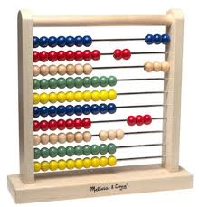
The Degree of Collaboration Abacus Tool
A visual metaphor to account for community partner voice in decision-making and collaboration responsibilities
Represents balance of power
Notes:
Note: Abacus is accessible.

Slide 6
Abacus Tool: The Sides
One side represents community partner’s voice in the decision-making.
The other side represents university partner’s voice in the decision-making.
Notes:
Note: Abacus is accessible.

Slide 7
Abacus Tool: The Rungs
Rungs represent the steps in collaborative, engagement processes.
They are specific to your type of community engaged scholarship.
Rungs may be re-named to match your project’s steps.
Notes:
Does the stages do not always progress linearly statement go here? I’m thinking it could be deleted here & mentioned on the Cavaeat’s slide later one.
That would make for a cleaner lead in to the next three slides.
Note: Abacus Tool is Accessible.

Slide 8
CE Research Abacus
Step in CE Research Process | Voice & Responsibility
 | Community University
1. Identify community issue(s) & assets
2. Decide on research question(s)
3. Select research design
4. Develop instrument/process
5. Collect data
6. Analyze data
7. Interpret data
8. Critically reflect, incl. limitations
9. Disseminate findings
10. Create academic products
11. Create public products
Notes:
HANDOUTS: One for most types of CES. We still need a good template for CE creative activities and other examples for CE Service and Practice.

Slide 9
CE Teaching & Learning For Credit Abacus
Steps in CE Teaching/Learning Process | Voice & Responsibility
 | Community University
1. Identify community issue(s) & assets
2. Develop learning objectives, outcomes
3. Recruit interested students
4. Match community & students
5. Orient students to community setting
6. Develop assignments/activities
7. Grade/feedback on assignments
8. Evaluate student performance
9. Evaluate partnership
10. Critically reflect on outcomes
11. Create academic products
12. Create public products

Slide 10
CE Teaching & Learning Not for Credit Abacus
Steps in CE Teaching/Learning Process | Voice & Responsibility
 | Community University
1. Identify community issue(s) & assets
2. Identify context—time, setting
3. Understand learners’ needs
4. Identify learning objectives, outcomes
5. Develop learning experiences
6. Provide learning experiences
7. Develop evaluation plan
8. Gather & analyze evaluation data
9. Critically reflect on experiences
10. Revise programming
11. Create academic products
12. Create public products

Slide 11
Abacus Tool: The Beads
Beads indicate which side—the community side or the university side—has more decision-making power and collaboration responsibilities.
More beads indicate more voice and responsibility.
Notes:
Note: Abacus tool is accessible

Slide 12
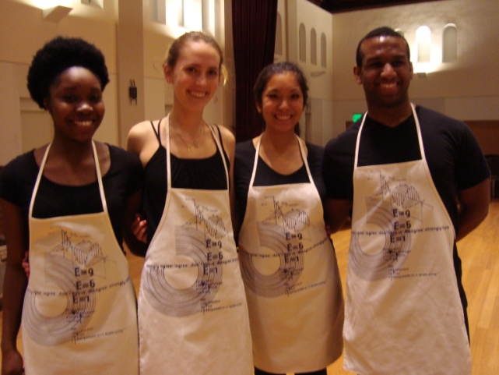
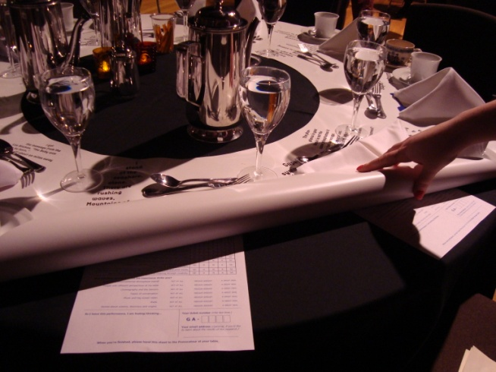
Example 1: The Matter of Origins Community Engaged Research
Choreographed by Liz Lerman and Dance Exchange
Multi-media dance contemporary dance performance
Act One
Act Two
Art/Science, Dance/physics collaboration designed to provoke thought and wonder at our origins.
Notes:
Note: photos are accessible.

Slide 13
The Matter of Origins Partnership Diagram
National Science Foundation
ISE-Eager Grant Program Officer
Dance Exchange
Liz Lerman
Choreographer
John Borstel
Humanities Director
Amelia Cox
Production Manager
Dance Exchange Dancers
6-7 Professionals
MSU Evaluation Team
Community Engagement Scholar
Senior Statistician
PhD Student
Sociology
Community Engaged Evaluation Research
Advisory Committee
MSU faculty
Community people involved in local dance
5 Performance/Host Sites
Performing Art Center Director
Local Provocateurs
Local Dancers
Tea Intensive
Local Dancers
Notes:
Structure—2nd type
Partnership Map
Duration—one-two years
Intensity of activity—varied, sometimes very intense (at the show), but lots of down time in between

Slide 14
The Matter of Origins Degree of Collaboration Abacus
Step in CE Research Process | Voice & Responsibility
 | Community University
1. Identify community issue(s) & assets
2. Decide on research question(s)
3. Select research design
4. Develop instrument/process
5. Collect data
6. Analyze data
7. Interpret data
8. Disseminate of findings
9. Create academic products
10. Create public products
Notes:
NOTE: Abacus is accessible.

Slide 15
Step | Voice and Responsibility
Identify community issue(s) & assets | Dance Exchange identified the grant opportunity to help fund the development, performance, and evaluation of an upcoming work—The Matter of Origins.
Decide on research question(s) | Dance Exchange wrote the grant to National Science Foundation—which broadly defines areas for evaluation in Informal Science Education. After many conversations and a visit to the Dance Exchange, the MSU research team identified general areas to explore through the research based on a combination of NSF’s, Dance Exchange’s, and the research team’s interests.
Select research design | National Science Foundation advocates for more rigorous (versus less rigorous) research designs. MSU research team and Dance Exchange selected an overall design, which was modified based upon the physical layout of the performance sites. This resulted in 5 different designs—one for each performance site, with slightly different emphases.

Slide 16
Steps | Voice and Responsibility
Develop instrument and process | Dance Exchange made sure the data collection process did not interfere with the audience members’ experience. Dance Exchange contributed ideas, word-smithed questions, and influenced size, shape, and color of instruments. MSU made sure survey questions mapped over to research questions and provided data that could be compared across research sites.
Collect data | Dance Exchange trained local dancers at each site to collect the data prior to the performance and at intermission. Dance Exchange trained provocateurs (tea table conveners) to collect data at the end of the performance. Dance Exchange collected delayed post-performance data through survey monkey. They then turned the data over to MSU to analyze.
Analyze data | MSU managed data entry and data analysis—of both qualitative and quantitative data.
Interpret data | MSU interpreted the data. Through phone calls with Dance Exchange, we focused on particular findings and iteratively refocused the evaluations, site by site so that the emphasis of each evaluation was slightly different.

Slide 17
Steps | Voice and Responsibility
Disseminate Findings | MSU provided, whenever requested, data for Dance Exchange to disseminate data to practitioner audiences—particularly for keynotes that Liz Lerman gave. MSU generated research reports with considerable input from Dance Exchange so that they were reader friendly. MSU generated an evaluation ideas booklet for others involved in art/science/engagement projects. MSU collaborated with Dance Exchange on dissemination to academic audiences—including conferences and peer reviewed journal articles.
Create Academic Products
Create Public Products

Slide 18
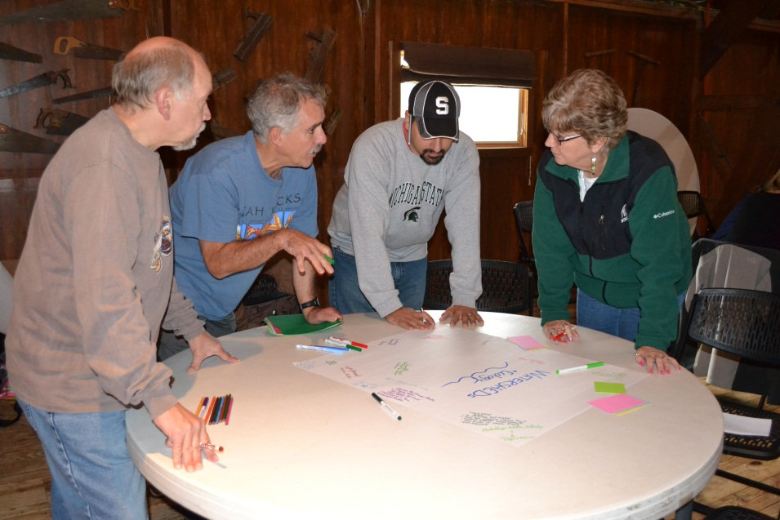
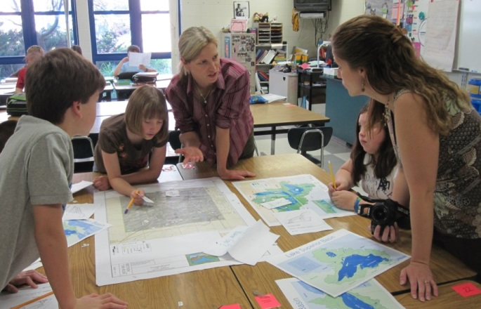
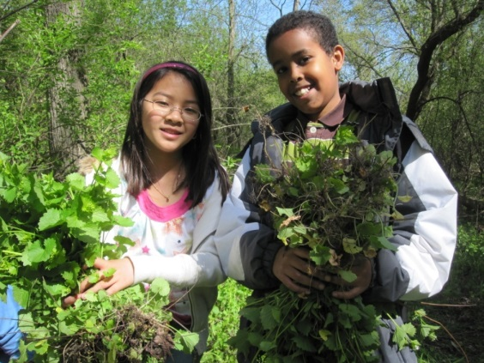
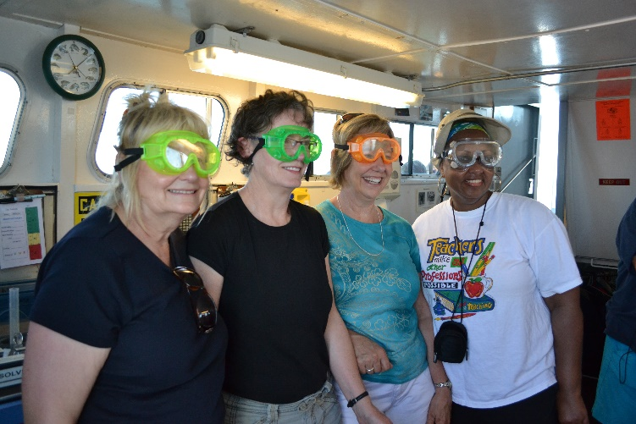
Example 2: GRAND Learning Network
Duration
2007 Planning Grant
2008- present programming
Intensity
High intensity
in terms of
staff hours,
participant time, & community collaboration
Structure
Network

Slide 19
GRAND’s Partnership Structure Diagram
Regional/State
Community Partners
Network Team
Teachers Students
Teacher Leaders
The “Hub”
In schools and local
communities
Local Community Partners
Notes:
In reality, the GRAND Learning Network is more than a “train the trainer program,” it is a complex network of hub-level relationships between MSU and Teacher Leaders, local community partners as well as regional and state partners, and most of all, the students themselves, who have voice and ownership of what conservation stewardship projects get done with community partners and MSU’s “guide on the side” support.

Slide 20
GRAND’s Two Layers of Engagement
Hub Layer
Individual School Layer
Teacher-Leaders from participating schools
+
Regional and state partners, incl. nonprofits, government agencies
+
MSU faculty, staff, students
Teacher-Leaders from participating schools
+
Teachers from those schools
+
Local community partners
+
HUB
Notes:
There are actually two layers of engagement in this case study.
First layer: the MSU partners, regional and state partners, and teacher-leaders from local schools collaborate to identify opportunities, resources, and partners for professional development around environmental stewardship and the Great Lakes. Teacher-leaders are from grades K-8 who are interested in advancing education for their students in innovative ways, but do not hold formal leadership positions in their schools, such as principal or administrators. Instead, the teacher-leaders collaborate with HUB partners to develop innovative teaching/learning activities for their classrooms and schools.
Second layer: The HUB and Teacher-leaders provide professional development and training for interested teachers at each of the participating schools, including urban, suburban, and rural K-8 schools in mid-Michigan. At this level, the teacher-leaders and teachers at each individual school develop ongoing partnerships with local, nearby community partners who collaborate to involve students in watershed stewardship projects and learning in the community.
Left Photo shows Teacher Leaders and includes Margaret Holtschlag, who is the teacher co-PI in this ongoing work in the GRAND Learning Network (she is second from the left).
Upper Right Photo: teacher Lisa Weise shares maps about the local watershed made specifically for her students by the Ingham County Drain Commissioner’s office, one of her many community partners.
Lower Right Photo: students removing invasive garlic mustard plants from the site of their community partner – a local nature center (Fenner Nature Center).

Slide 21
GRAND’s Hub Layer Abacus
The Hub =
Steps in CE Teaching & Learning | Voice and Responsibility
 | Community University
1. Identify community issue(s) & assets
2. Identify context – time, setting
3. Understand learners’ needs
4. Develop outcome objectives
5. Develop learning experiences
6. Identify evaluation questions
7. Design evaluation methods
8. Analyze evaluation data
9. Critically reflect on experiences
10. Revise programming
11. Create academic products
12. Create public products

Slide 22
GRAND’s Individual School Layer Abacus
Teachers & Students in Schools =
Stage in CE Teaching & Learning | Voice and Responsibility
 | Community University
1. Identify community issue(s) & assets
2. Identify context – time, setting
3. Understand learners’ needs
4. Develop outcome objectives
5. Develop learning experiences
6. Identify evaluation questions
7. Design evaluation methods
8. Analyze evaluation data
9. Critically reflect on experiences
10. Revise programming
11. Create academic products
12. Create public products

Slide 23
GRAND Learning Network Degree of Collaboration Abacus
Teachers & Students in Schools =
The Hub =
Steps in CE Teaching/Learning Process | Voice & Responsibility
 | Community University
1. Identify community issue(s) & assets
2. Identify context – time, setting
3. Understand learners’ needs
4. Develop outcome objectives
5. Develop learning experiences
6. Identify evaluation questions
7. Design evaluation methods
8. Analyze evaluation data
9. Revise programming
10. Create academic products
11. Create public products

Slide 24
When To Use The Abacus Tool
Initial discussions with (potential) partners—establish a basic understanding of what the steps are in the process.
Formalizing partnership agreements, including memoranda of understanding—to clarify who has decision-making power and collaboration responsibilities at each stage.
Grant-writing—to use as a visual to demonstrate proposed shared decision-making and collaboration responsibilities.

Slide 25
When to Use the Abacus Tool, continued
Reflective practice mid-way through a project—to clarify how the collaboration is going and ask/reflect on whether initial decision-making and responsibilities might need to be re-negotiated.
Project wrap up, final reflection and reporting—to depict how decision-making and collaboration responsibilities were actually divided (revisions may be needed).
Teaching/learning tool—to help undergraduate and graduate students understand various stages in process and visualize shared decision-making and collaboration responsibilities with the community partners.

Slide 26
Caveats
Many partnerships are more complicated than two partners, especially community-engaged teaching and learning, which may include multiple partners and relationships: administrators, faculty, students, community organizations, and community residents (Bringle, Clayton, & Price, 2011, pg. 16).
Notes:
Note: SOFAR model is accessible.

Slide 27
Caveats, Continued
Community-engaged scholarship is often iterative, either by design or by circumstance, so that steps represented by rungs may repeat themselves in an iterative cycle rather than a linear progression.
Community-engaged scholarship may involve different partners at different phases of the process.
Notes:
NOTE: action research cycle loops are accessible.

Slide 28
Invitation
You are invited to adapt the Degree of Collaboration Abacus Tool to reflect your community engagement partners and context.
Be creative in making modifications that reflect your lived experience of sharing decision-making and collaboration responsibilities with your community partner(s).
Let us know what your abacus looks like!

Slide 29
Acknowledgements
We would like to thank Timothy K. Stanton, author of the 2008 New Times Demand New Scholarship: Opportunities and Challenges for Engagement at Research Universities, journal article and The Research University Community Engagement Network (TRUCEN) publication, for sparking our imagination with Figure 2: Degree of Collaboration in Research Processes (pg. 26).
With his permission, we have re-imagined his figure into the Abacus Tool and extended it beyond community-engaged research to address multiple forms of community-engaged scholarship, including community-engaged teaching and learning, community-engaged service and practice, and community-engaged commercialized activities.

Slide 30
References
Arnstein, S. (1969, July) A ladder of citizen participation. AIP Journal 26, 216–214.
Bringle, R. G., Clayton, P. H., & Price, M. F. (2009). Partnerships in Service Learning and Civic Engagement. Partnerships: A Journal of Service Learning and Civic Engagement 1(1), 1-20.
Cornwall, A. (2008). Unpacking “participation”: Models, meanings, and practices. Community Development Journal 43(3), 269-283.
Doberneck, D. M., Glass, C. R., & Schweitzer, J. H. (2012). Beyond activity, partner, and place: How publicly engaged scholarship varies by intensity of activity and degree of engagement. Journal of Community Engaged Scholarship 4(2), 18-26.
Fraser, F. (2005). Four different approaches to community participation. Community Development Journal 40, 286-300.

Slide 31
References, Continued
Hage, M., Leroy, P., & Petersen, A. C. (2009). Stakeholder participation in environmental knowledge production. Futures 42, 254-264.
Hart, R. A. (1997). Children’s Participation: The Theory and Practices of Involving Young Citizens in Community Development and Environmental Care. London, UK: Earthscan.
International Association for Public Participation. (2007). IAP2’s Spectrum of public participation. Retrieved from: http://c.ymcdn.com/sites/www.iap2.org/resource/resmgr/imported/IAP2%20Spectrum_vertical.pdf.
Kessler, B. L. (2004). Stakeholder participation: A synthesis of current literature. Silver Spring, MD: National Marine Protected Areas Center, National Oceanic and Atmospheric Administration. Retrieved from: http://marineprotectedareas.noaa.gov/pdf/publications/Stakeholder_Synthesis.pdf.

Slide 32
References, Continued
Pretty, J. (1995) Participatory learning for sustainable agriculture. World Development 23(8), 1247–1263.
Reed, M. S. (2008). Stakeholder participation for environmental management: A literature review. Biological Conservation 141, 2417-2431.
Reed, M. S., Graves, A., Dandy, N., Posthumus, H., Hubacek, K., Morris, J., Prell, C., Quinn, C. H., & Stringer, L. (2009). Who’s in and why? A typology of stakeholder analysis methods for natural resource management. Journal of Environmental Management 90, 1933-1949.
Sandmann, L. R. (2006). Scholarship as architecture: Framing and enhancing community engagement. Journal of Physical Therapy 20(3), 80-88.
Stanton, T. K. (2008). New times demand new scholarship: Opportunities and challenges for engagement at research universities. Education, Citizenship, and Social Justice 3(1), 19-24.

Slide 33
Contact Information
Diane M. Doberneck, Ph.D., connordm@msu.edu
Shari L. Dann, Ph.D., sldann@msu.edu
University Outreach and Engagement
Michigan State University Kellogg Hotel and Conference Center 219 S. Harrison Road, Suite 93
East Lansing, MI 48824
Phone: 517-353-8977 Fax: 517-432-9541
E-mail: outreach@msu.edu Web: outreach.msu.edu
© Michigan State University Board of Trustees

